Slide 1
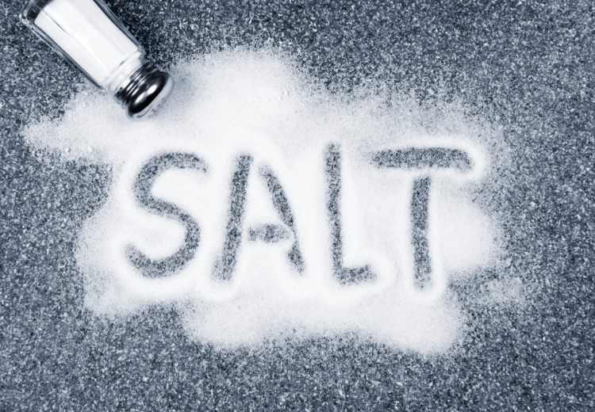
Password Protection

Slide 2

Secure Passwords
Most developers, will have to make a user account system at some stage.
The most important aspect of a user account system is how user passwords are protected.
User account databases are hacked frequently, so you absolutely must do something to protect your users' passwords if your website is ever breached.
In the news : Millions of financial records leaked from server not protected by password
Recent news
The best way to protect passwords is to use salted password hashing.

Slide 3
Password Protection What’s important?
We need a way to:
Store passwords in a form that protects them even if the password file itself is compromised
Be able to verify that a user's password is correct.

Slide 4
Lets look at a typical Registration and Authentication Workflow….
User Creates an account
Password is hashed and stored in the database
User attempts to login, the hash of the entered password is checked against the stored hash
If the hashes match, the user is granted access, otherwise invalid credentials have been entered
Never tell if it was the username or password!

Slide 5

Are we secure now? Are finished protecting the user?
Not quite!
Actually we’re still far from the security meaning.
There are many ways to recover passwords from plain hashes very quickly….

Slide 6
Hashing Calculators..
https://md5hashing.net/

Slide 7
Cracking Hashes
Dictionary Attacks
Uses a file containing words, phrases, common passwords.
Further processing is often applied, like replacing words with their "leetspeak" equivalents ("hello" becomes "h3110"), to make them more effective.
Each word in the file is hashed, and its hash is compared to the password hash
Trying Banana : Failed
Trying Pineapple : Failed
Trying Orange : Failed
……
Trying Secret : Failed
Trying S3cr3t :
SUCCESS

Slide 8
Cracking Hashes
Brute Force Attacks
Tries every possible combination of characters up to a given length.
They are very computationally expensive, the least efficient in terms of hashes cracked per processor time
We cannot prevent Brute Force OR Dictionary Attacks, But they can be made less effective!
Trying aaaa : Failed
Trying aaab : Failed
Trying aaac : Failed
……
Trying adbc : Failed
Trying adbd :
SUCCESS

Slide 9
Other problems..
Two fundamental problems:
(a) user-memorable passwords typically don't contain as much randomness as we need for a secure key; Letterkenny123, Liverpool20, Arsenal23, Lassie1992
(b) in a typical application, an attacker gets as many tries as they like at the password.
An additional problem is that if, the password abc123 always generates the same key in our application.
Then an attacker could calculate the key from this password once and then quickly decrypt any data protected with this password.

Slide 10

Password Protection
There are two common techniques are used in password-based encryption to try to alleviate these problems:
A deliberately slow method (PBKDF2) is used to create the encryption key from the password, reducing the number of guesses that an attacker can make in a given time frame.
The calculation is intentionally slowed down to make it harder for an attacker to brute-force the user passwords in case the password database gets stolen for example.
Some random bytes, called a salt, are appended to the password before it is used to calculate the encryption key.

Slide 11
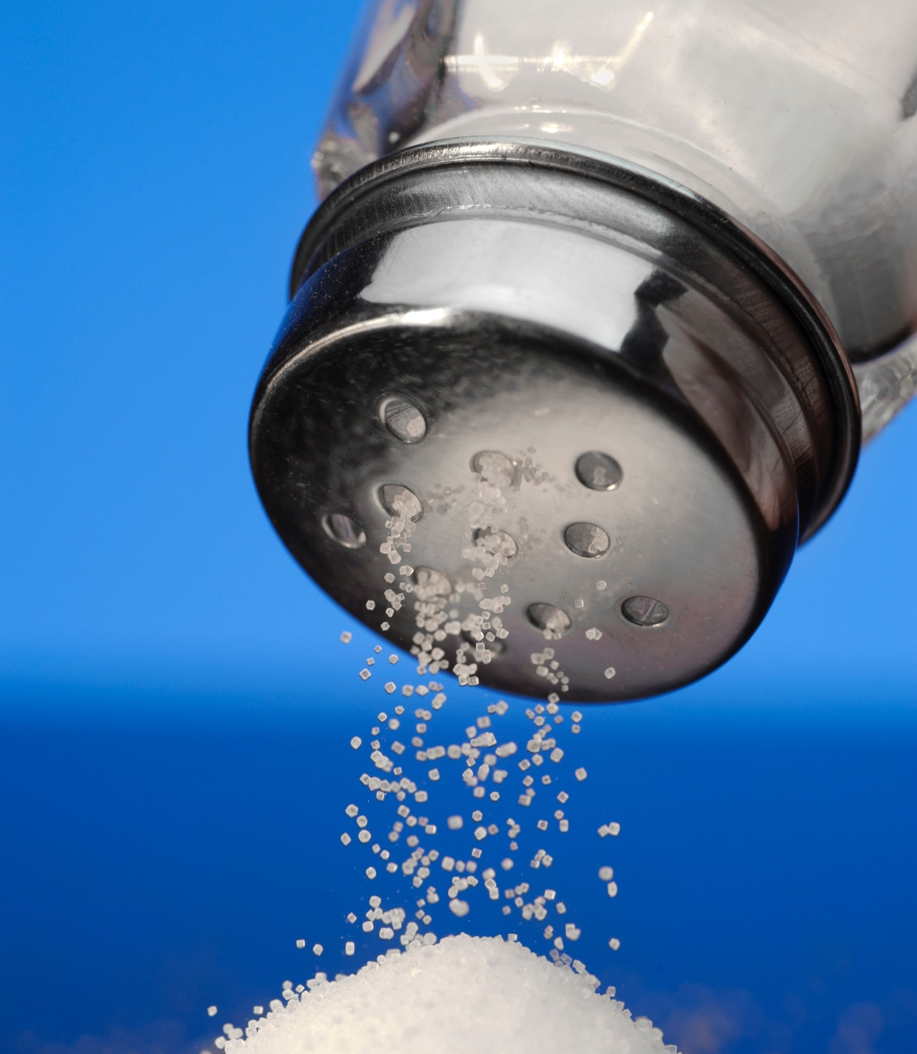
Adding SALT
Salting randomises the hashes by appending (either at the start or at the end) a random string, called a salt, to the password before hashing.
To check if a password is correct, we need the Salt, so it is usually stored in the user account database along with the hash, or as part of the hash string itself.
The idea of salt is that when the user enters the password, we don't actually use just the raw password to generate the key. We first add some random bytes to the password.
A new, random salt is used for every file/piece of data being encrypted.

Slide 12

SALT
The salt bytes are not secret: they are stored unencrypted along side the encrypted data.
This means that the salt bytes would add no extra security if there was only once piece of data in the world encrypted with a given password.
But they prevent dictionary attacks, where an attacker pre-computes the keys from some common passwords and then tries those keys on the encrypted data.
With the salt bytes, the attacker is forced to run the slow key derivation function for each password they want to try on each piece of data.

Slide 13
Why use SALT?
Why use a salt for your passwords?
Prevents the identification of identical passwords
Provided each user has a different salt, All password guesses are salt-specific.
Guess made with one salt aren’t helpful for another
Increases the cost of offline attack to crack any password in the file
Increases the size requirement for a pre- computed database of hashed passwords

Slide 14

The Basics: Hashing with Salt
So how do we generate the salt, and how do we apply it to the password?
Salt should be generated using a Cryptographically Secure Pseudo-Random Number Generator (CSPRNG).
CSPRNGs are very different than ordinary pseudo-random number generators, like the "C" language's rand()function.
CSPRNGs are designed to be cryptographically secure, meaning they provide a high level of randomness and are completely unpredictable.

Slide 15
The Basics: Hashing with Salt We don't want our salts to be predictable, so, we must use a CSPRNG. The following table lists some CSPRNGs that exist for some popular programming. platforms
Platform | CSPRNG
Java | java.security.SecureRandom
PHP | mcrypt_create_iv, openssl_random_pseudo_bytes
Dot NET (C#. VB) | System.Security.Cryptography.RNGCryptoServiceProvider
Ruby | SecureRandom
Python | os.urandom
Perl | Math::Random::Secure
C/C++ (Windows API) | CryptGenRandom
Any language on GNU/Linux or Unix | Read from /dev/random or /dev/urandom

Slide 16
How do we SALT in Java?
To generate salt bytes in Java, we just need to make sure that we use a secure random number generator.
Construct an instance of SecureRandom, create (say) a 20-byte array, and call nextBytes() on that array:
SecureRandom r = new SecureRandom();
byte[] salt = new byte[20];
r.nextBytes(salt);

Slide 17
Solution - java.util.SecureRandom
So as you've probably guessed, our solution to the problem is to use SecureRandom instead:
import java.security.SecureRandom;
..
SecureRandom ranGen = new SecureRandom();
byte[] aesKey = new byte[16]; // 16 bytes = 128 bits
ranGen.nextBytes(aesKey);

Slide 18
The Java SecureRandom class
The SecureRandom class, housed in the java.security package, provides a drop-in replacement to java.lang.Random.
But unlike the java.lang.Random, java.security.SecureRandom is designed to be cryptographically secure.
So, when should you use SecureRandom?

Slide 19

When to use SecureRandom
SecureRandom is typically used in cases where, random numbers are generated for security related purposes, such as generating an encryption key or session ID;
Why is it important to be random?
If we use the generator to produce, a session ID on a web server: we don't want user n to predict user n+1's session ID.
Example, we don't want a user in an Internet cafe, based on the session ID or encryption key that they are given, to access a web site, to be able to predict the value assigned to a previous user on that machine.

Slide 20

When NOT to use SecureRandom
CPU usage may be an issue, for example, in:
When we need a moderate quantity of numbers needs t be generated but where there are "better things to spend the CPU time on" (e.g. a game where the quality of randomness isn't crucial);
Lotto numbers??

Slide 21
SALT
How many salt bytes should you use?
Well, not too few! Usually not less than 64 bytes. Most experts recommend 128.
But there's also no point in using more salt bytes than the random number generator can generate!
For example, SecureRandom, which is based internally on the 160-bit SHA-1 hash function, can only generate 2¹⁶⁰ possible sequences of any length.
So there is absolutely no point in using more than 160 bits of salt (=20 bytes) with this generator.
Never use a weak random number generator such as java.util.Random to generate salt bytes!
Never use a weak cryptography method (MD5)

Slide 22
Steps for Salting a password
To Store a Password
Generate a long random salt using a CSPRNG.
Append or PreAppend the salt to the password and hash it with a standard password hashing function like SHA1, etc...
Save both the salt and the hash in the user's database record.

Slide 23
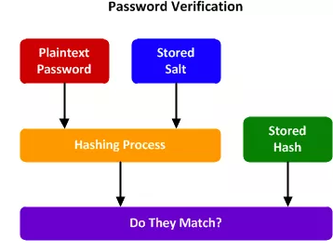
Steps for Salting a password
To Validate a Password
Retrieve the user's salt and hash from the database.
Prepend the salt to the given password and hash it using the same hash function.
Compare the hash of the given password with the hash from the database.
If they match, the password is correct. Otherwise, the password is incorrect.

Slide 24

Remember
The salt needs to be unique per-user and per-password.
Every time a user creates an account or changes their password, the password should be hashed using a new random salt.
Never reuse a salt.
The salt also needs to be long, so that there are many possible salts.
As a rule of thumb, make your salt is at least as long as the hash function's output.
The salt should be stored in the user account table alongside the hash.

Slide 25
Salt Implementation Errors
The most common salt implementation errors are reusing the same salt in multiple hashes, or using a salt that is too short.
Salt Reuse
Short Salt

Slide 26
Salt Reuse
A common mistake is to use the same salt in each hash.
Either the salt is hard-coded into the program, or is generated randomly once.
This is ineffective because if two users have the same password, they'll still have the same hash.
An attacker can use a reverse lookup table attack to run a dictionary attack on every hash at the same time.
They just have to apply the salt to each password guess before they hash it.
Note: A new random salt must be generated each time a user creates an account or changes their password.

Slide 27
Short Salt
If the salt is too short, an attacker can build a lookup table for every possible salt.
For example, if the salt is only three ASCII characters, there are only 95x95x95 = 857,375 possible salts.
That may seem like a lot, but a lookup table with the most common passwords contains around 1024 bytes,
This means that the rainbow tables for the possible salts, with the most common passwords would be around 837 GB
Which is not a lot considering 1000GB hard drives can be bought for under €100 today.

Slide 28

Practical for this week
Lab 3 – SALT
Must be submitted as part of your CA
Code available on Blackboard.
More details in Practical Classes this week.

